Slide 1

Cyber-sec intro
Mohamed Rahman Shareff S
B.Sc. (Hons.) Cloud Comp & Big Data

Slide 2


Security ?
SOCIAL MEDIA
spyware
CLOUD SEC
iot
cryptography
phishing
Forensics
application

Slide 3




Slide 4


Slide 5
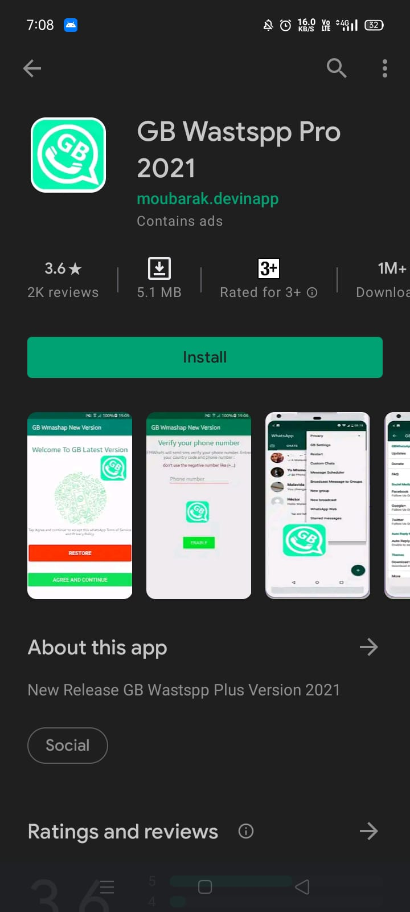
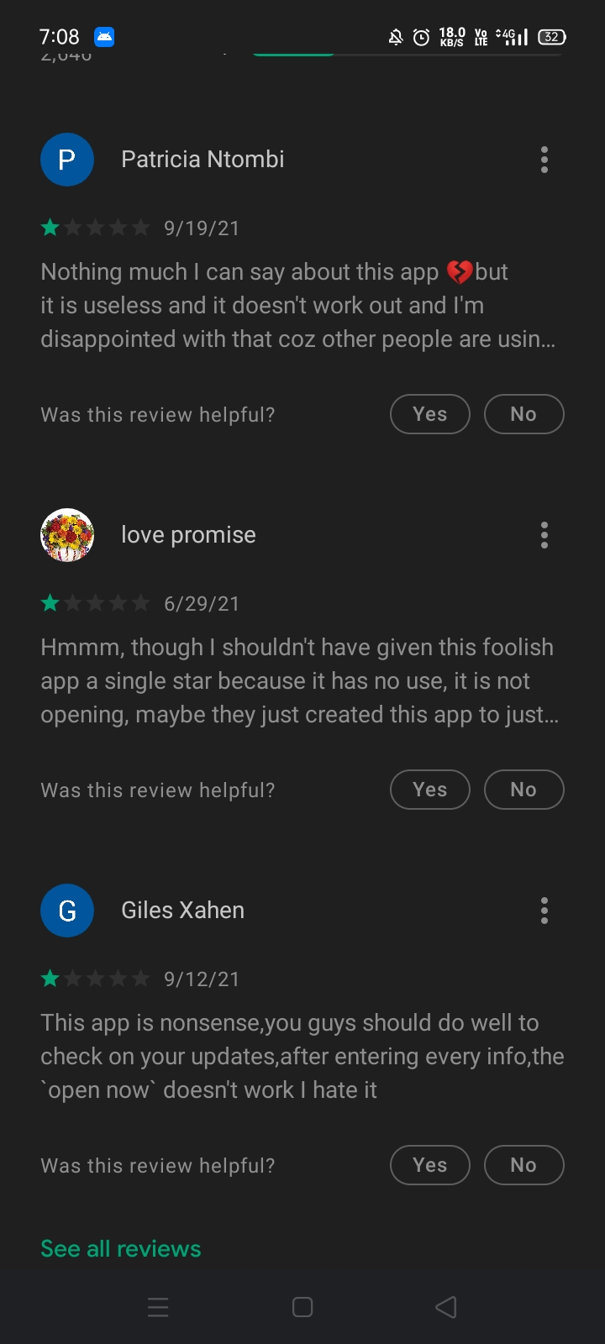
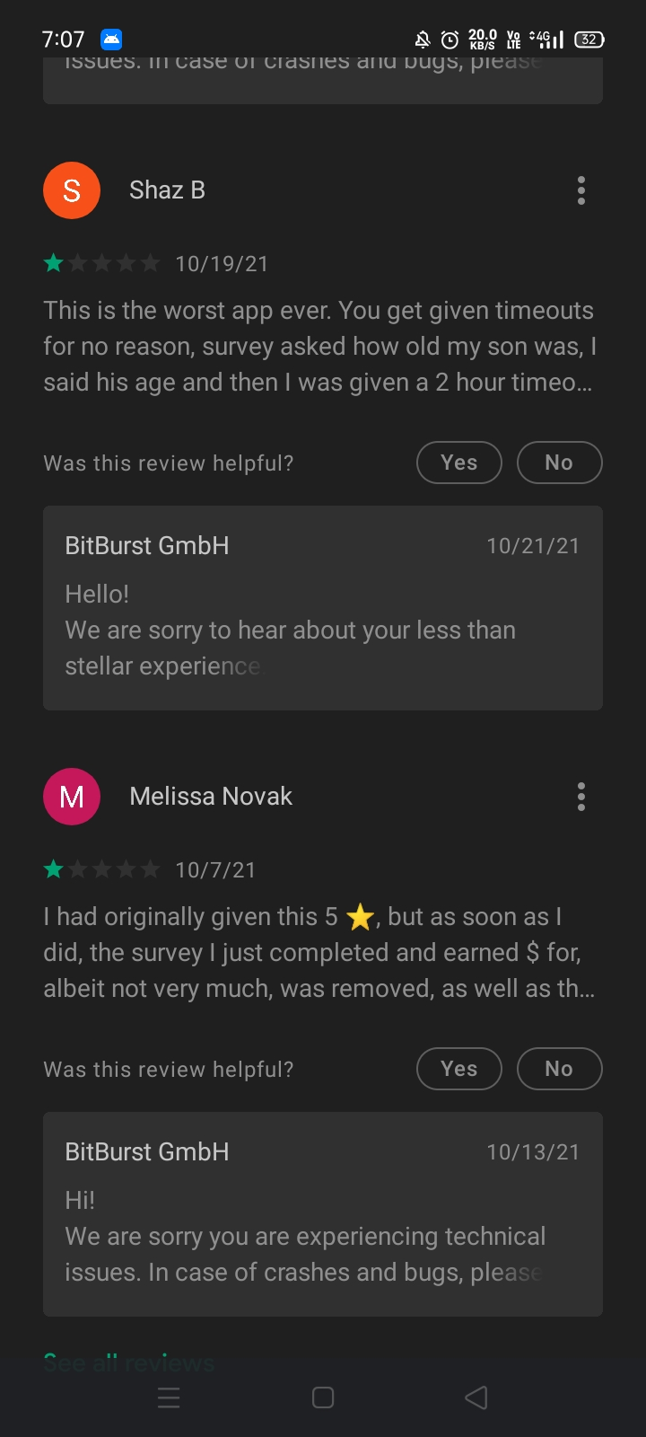

Slide 6
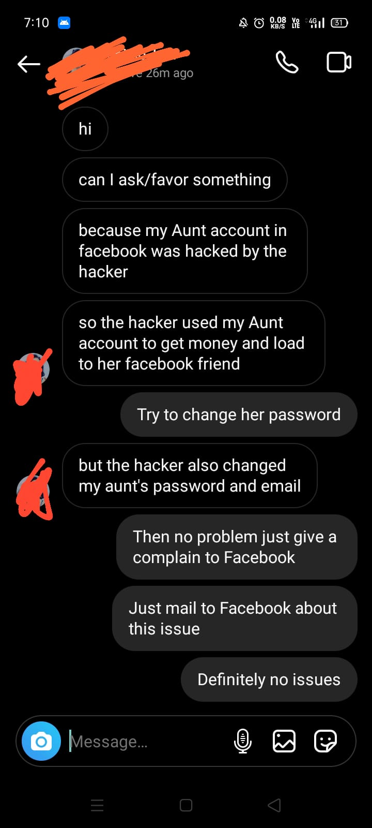
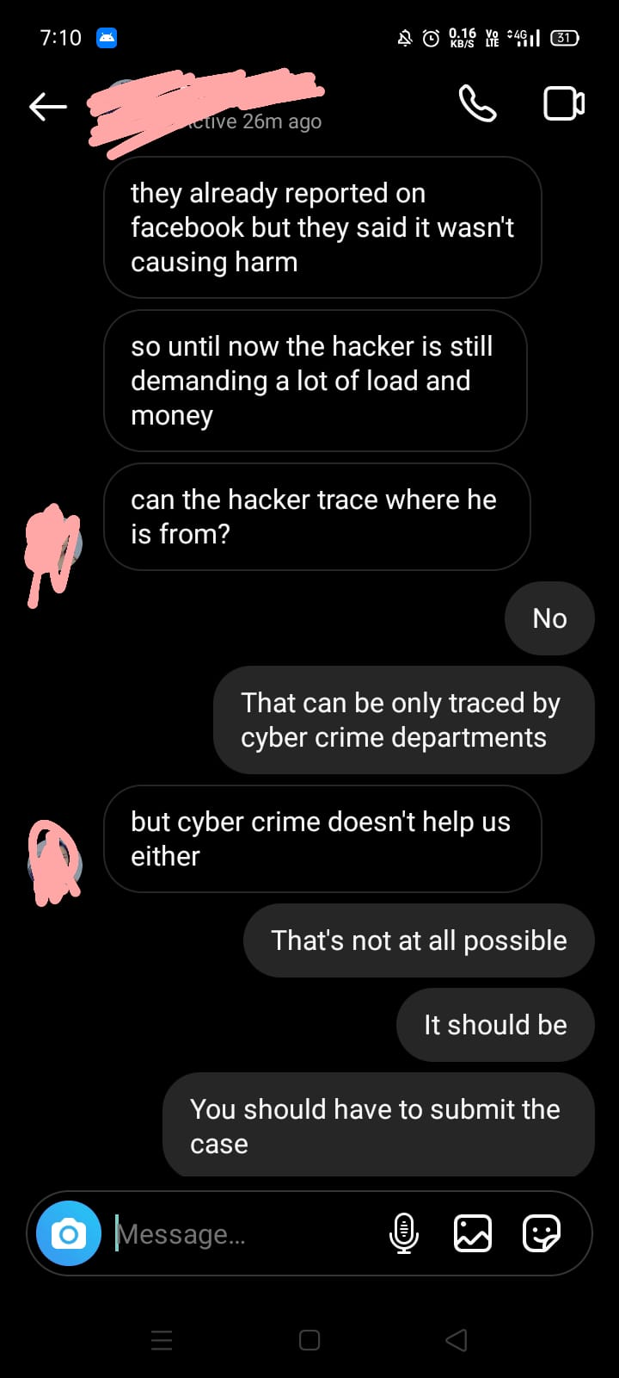
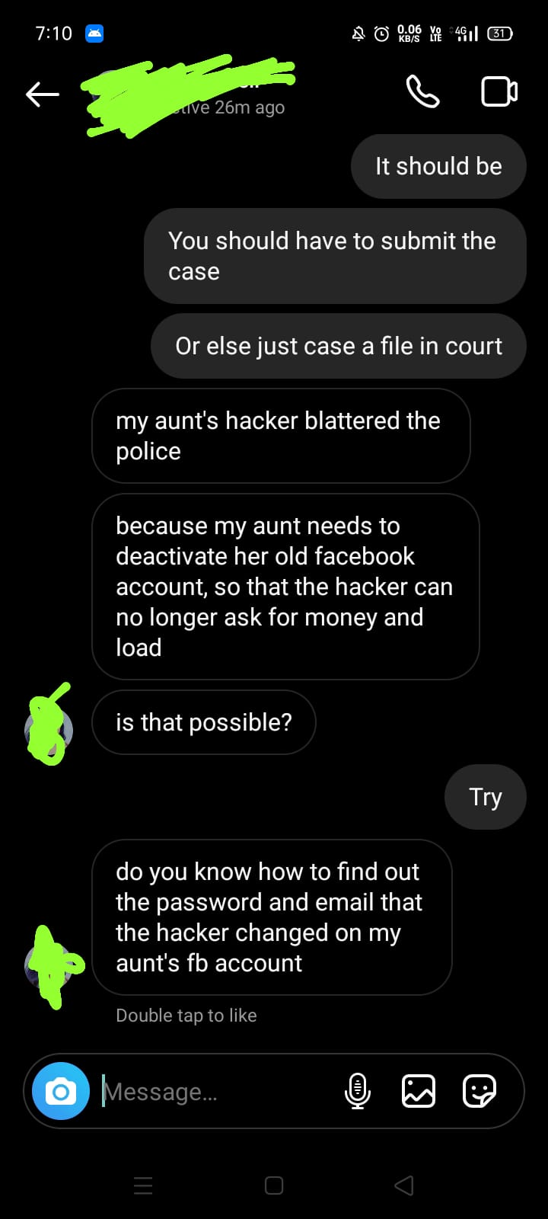

Slide 7
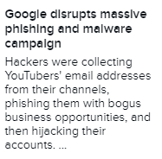
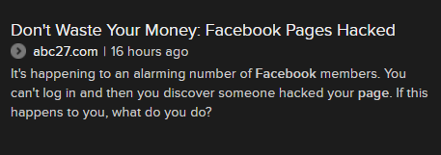
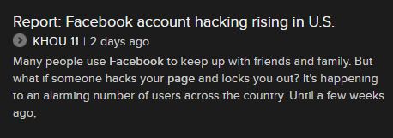
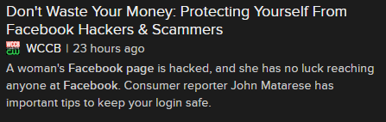
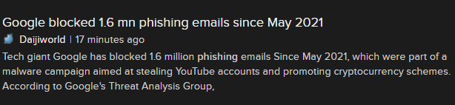
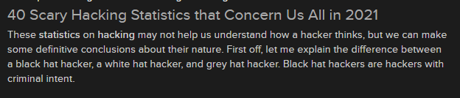
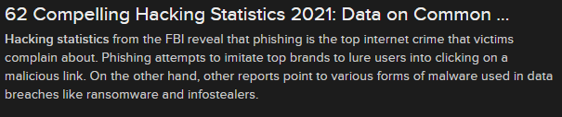

Slide 8
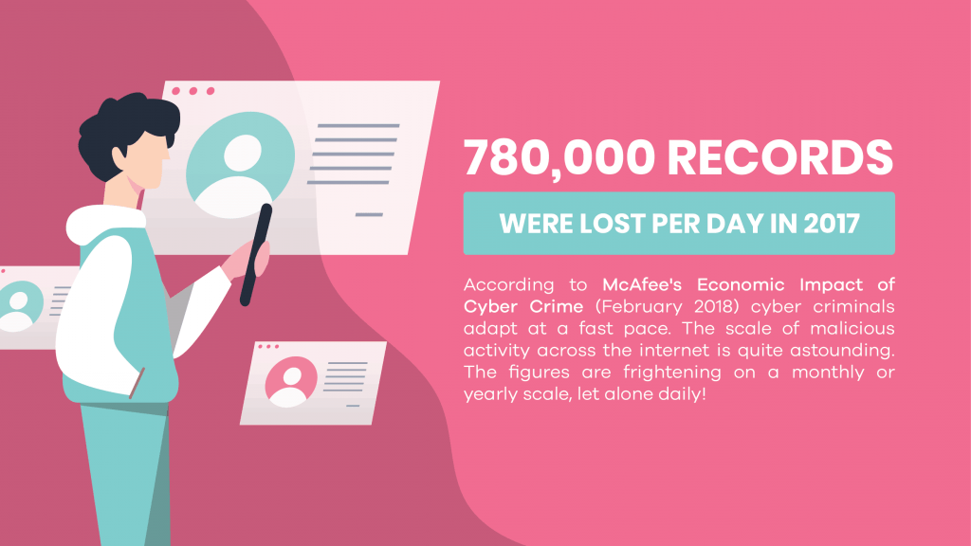
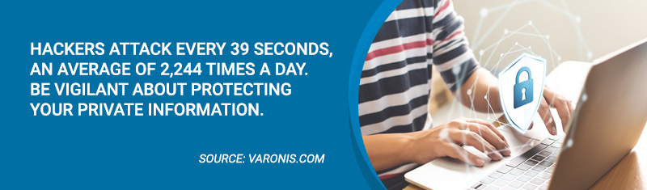

Slide 9
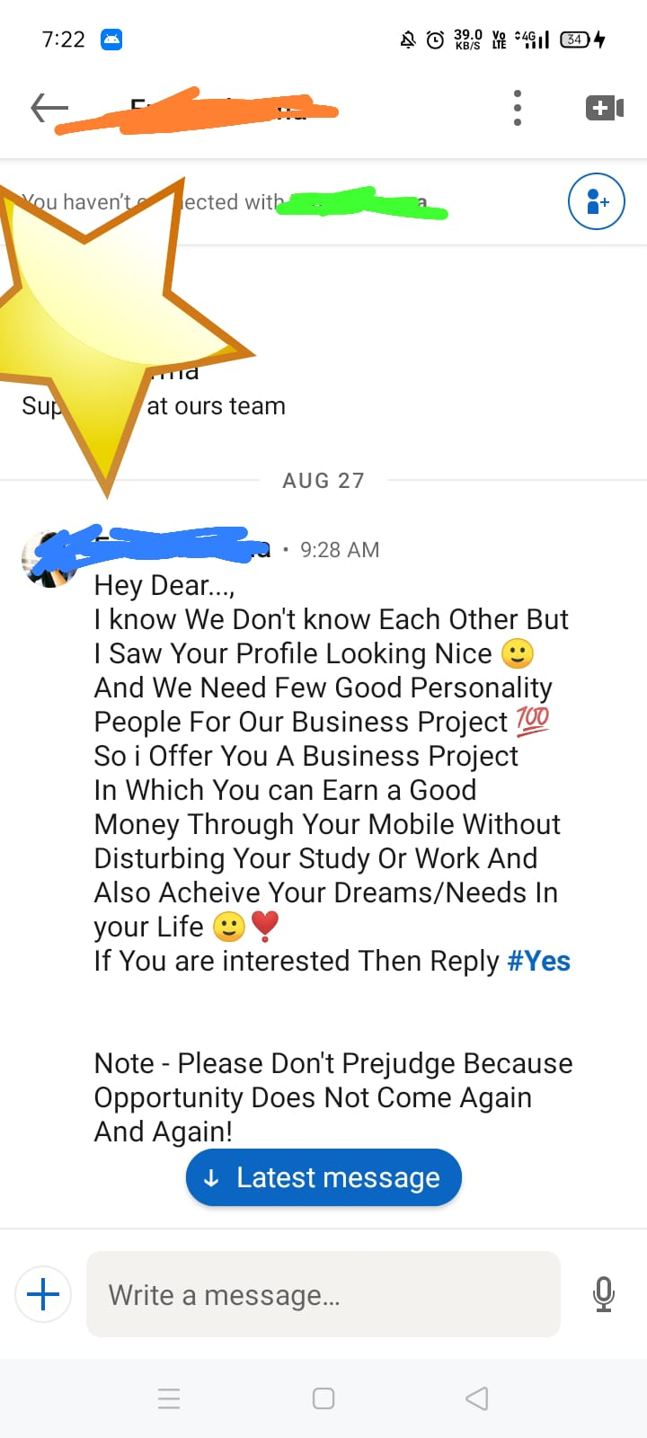

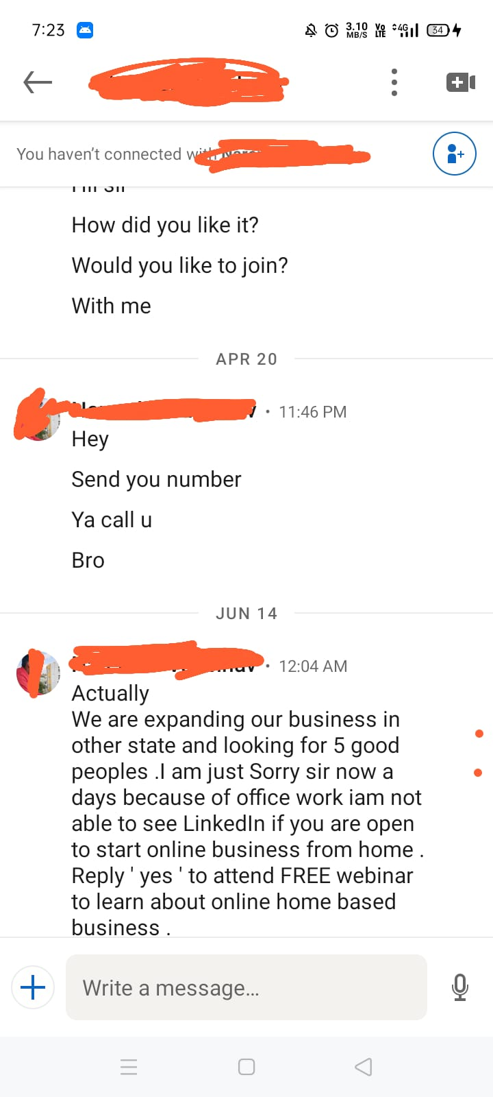


Slide 10
Hacks!!!! – SOCIAL ENGINEERING……
JOBS
FRIENDS
SOCIAL MEDIA’S
PERSONAL BEHAVIOUR
PSYCOLOGICAL MINDSET

Slide 11
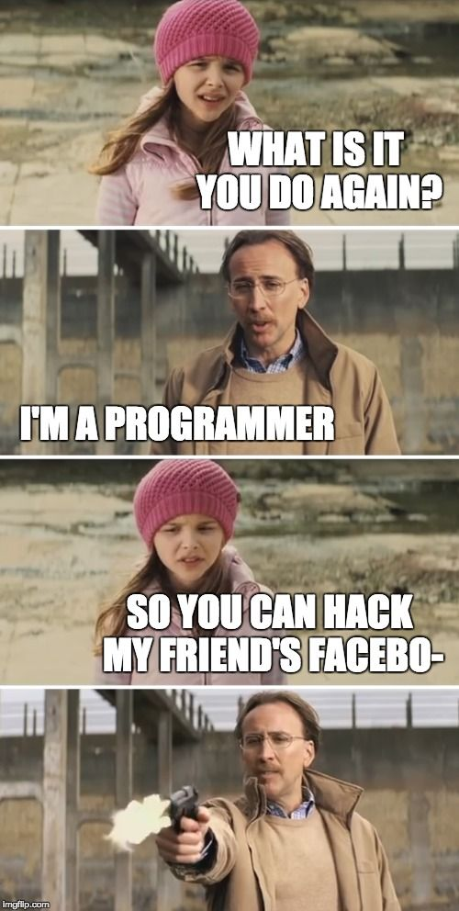
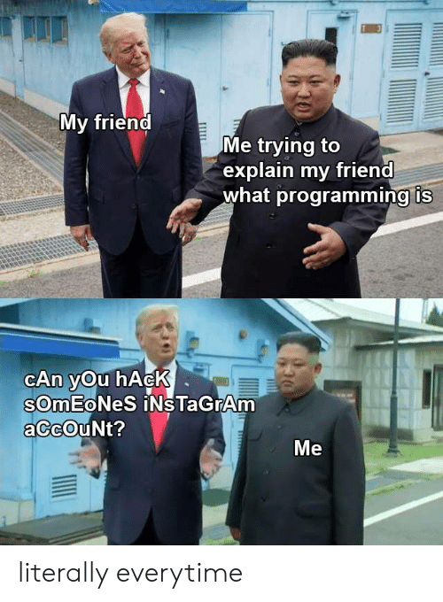
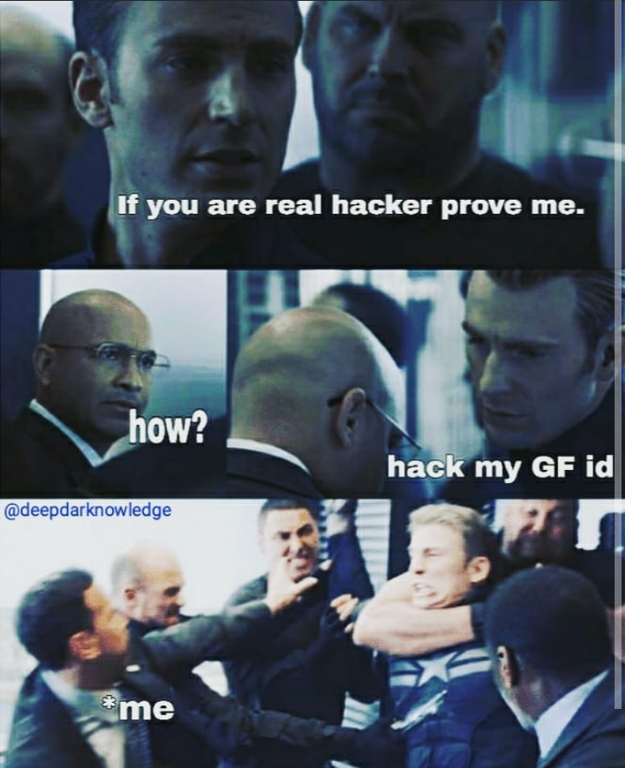

Slide 12
AGENDA
WHY YOU GET HACK!
SKILLS NEEDED
HACKED
HACKING
HACKER
CYBER SECURITY
TERMINOLOGIES
CYBER SEC FIELDS
FORENSICS
PENETRATION TESTING
IOT SEC
CLOUD SECURITY
CRACKED APPS

Slide 13
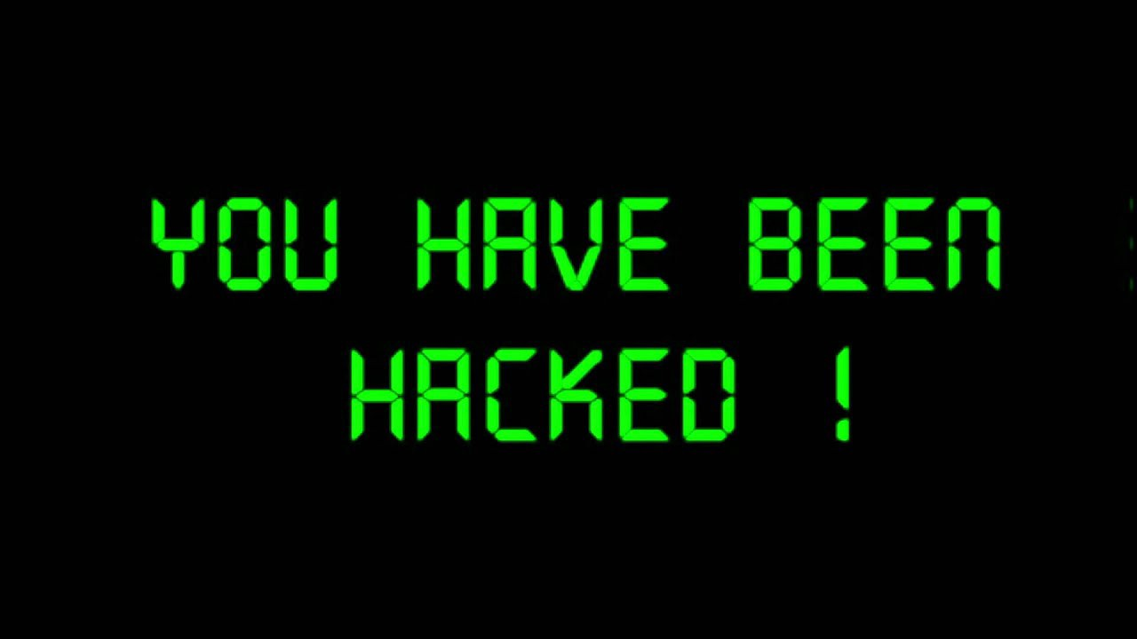
Why do you hack buddy???
Just for fun
Black mail
Show off
Steal important Info
Damaging the system
Break Privacy
Money
System testing
To break policy

Slide 14
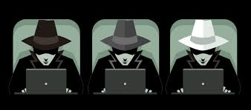
Types of Hackers

Slide 15
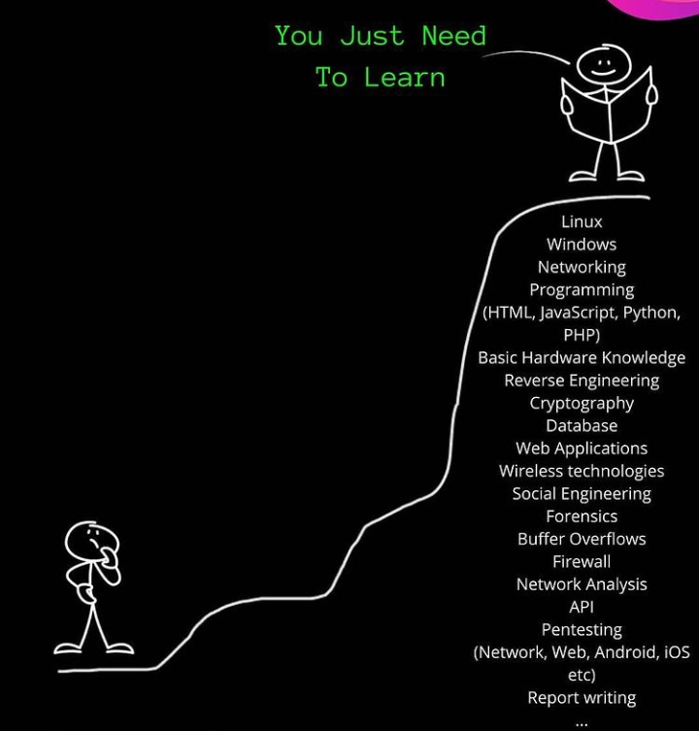
Skills needed??
Basic computer skill
Networking Skill
Linux Skill
Programming Skills
Basic Hardware Skills
Cryptography
Reverse Engineering
Database Skills

Slide 16
Hacker ??
The term hacker was born in the sixties (60’s) in the MIT Community
It refers to the people who prefer to understand how a system works rather than just using it.
These people are curious, highly intelligent and strongly motivated to pursue knowledge.
Being a hacker means being pushed by curiosity and having a hunger for knowledge. Hackers explore and improve their skills daily
INE : Penetration Testing Student (eJPT)

Slide 17
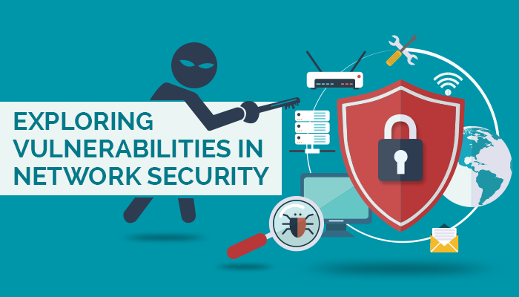
Hacking?
Hacking is identifying the vulnerabilities (Weakness) from the system or the network and exploiting the weakness to gain the access

Slide 18
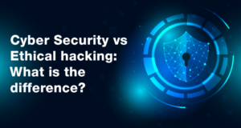
DIFFERENCE BETWEEN hacking & CYBER Security

Slide 19
Cyber security
Ethical HACKING
Cyber Security is a combination of different skills and tools, which combines together to provide the best security environment to users.
Ethical Hacking is part of Cyber Security, which mainly deals with finding vulnerabilities in a system and solving them before any malicious or black-hat hacker exploits them.

Slide 20
Terminologies!
ADWARE
BRUTEFORCE
DOS
DDOS
ENCRPTION
MALWARE
PAYLOAD
PHISHING
RANSOMWARE
RAT
SPOOFING

Slide 21
Cyber security field??
SYSTEM SECURITY PENETRATION TESING
WEBSITE SECURITY PENETRATION TESING
APPLICATION SECURITY PENETRATION TESING
NETWORK SECURITY PENETRATION TESING
IOT SECURITY
CLOUD SECURITY
API SECURITY
LOT MORE ……….

Slide 22
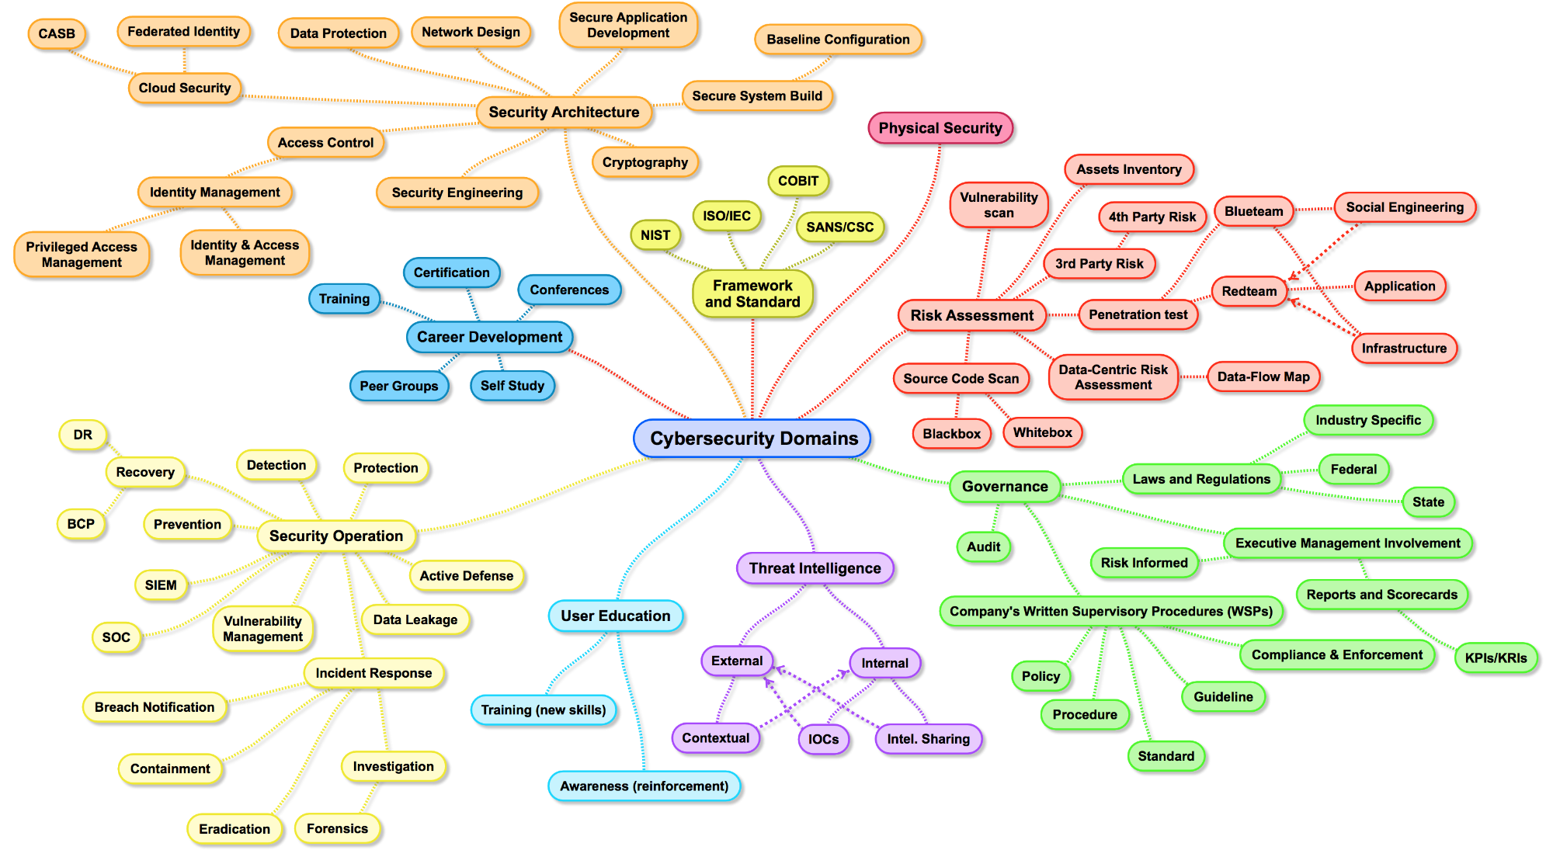

Slide 23
FORENSICS?? I MEAN (DIGITAL)
Digital forensics is a modern day field of forensic science, which deals with the recovery and investigation of material found in digital devices

Slide 24
Reason !!
Identifying the leak within an organization
Accessing the possible damage that occurred during a breach
Reconstruct crime scene
Every contact by a criminal leaves behind a trace

Slide 25
Procedure please??
Identification – identify crime scene / crime happen
Preservation – Warrant, first responder, seize evidence, transport FSL
Extraction – bit-by-bit copy, md5, SHA, chain of custody
Interpretation – Analysis
Documentation – Report generation
Presentation – Show evidence at court

Slide 26
Penetration testing??
A penetration test, also known as a pen-test or ethical hacking, is an authorized simulated cyberattack on a computer system, performed to evaluate the security of the system.

Slide 27
Penetration testing phases:
RECONNAISANCE (INFORMATION GATHERING)
SCANNING
GAINING ACCESS
MAINTAINING ACCESS
COVERING TRACKS

Slide 28
RECONNAISSANCE TYPES!!
ACTIVE RECONNAISSANCE :
Active reconnaissance occurs when the attacker engages directly with the targeted system to acquire information on it.
This form of reconnaissance is faster to perform and generally yields more actionable information
PASSIVE RECONNAISSANCE :
Passive reconnaissance occurs when information is gathered from the targeted system without engaging with the system directly.

Slide 29
scanning:
Wireshark
Nmap (Network Mapper)
Nessus
Nikto
Acutenix
Metasploit Framework
OpenVAS
Intruder
Qualys

Slide 30
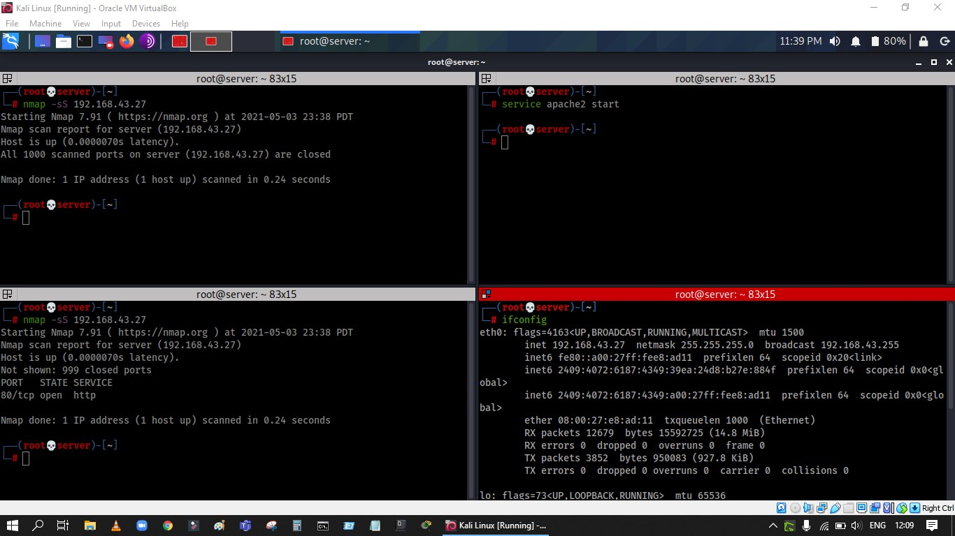

Slide 31
Gaining access??
Metasploit Framework
John The Ripper
IronWASP
SQL MAP
SQL NINJA
Maltego
Burp Suite
NetStumbler
Aircrack-ng
Ettercap

Slide 32
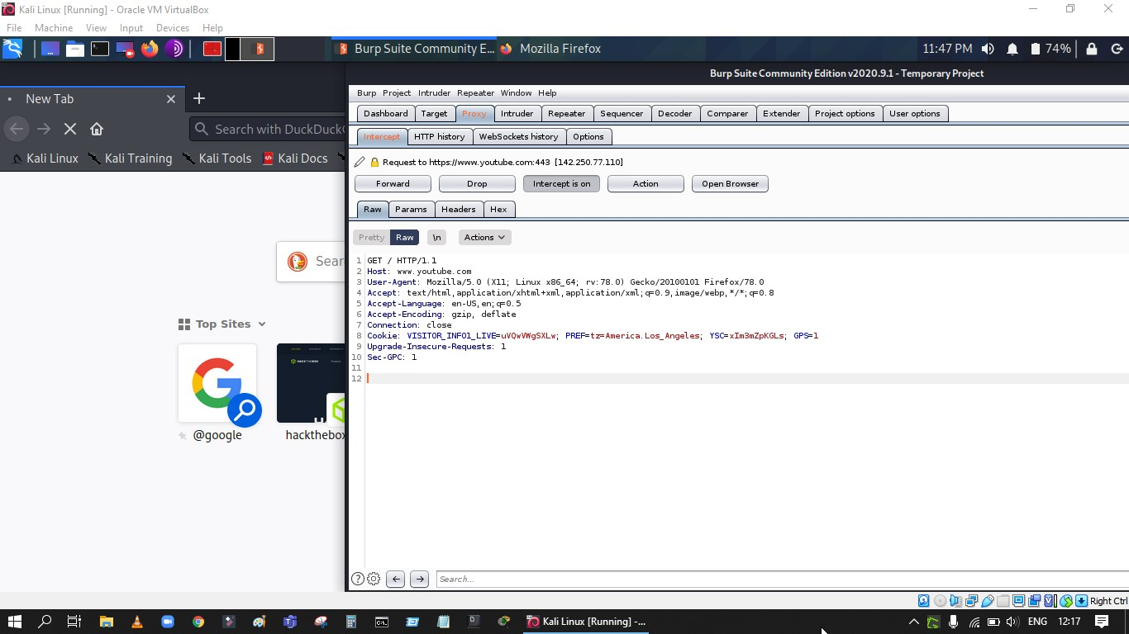

Slide 33
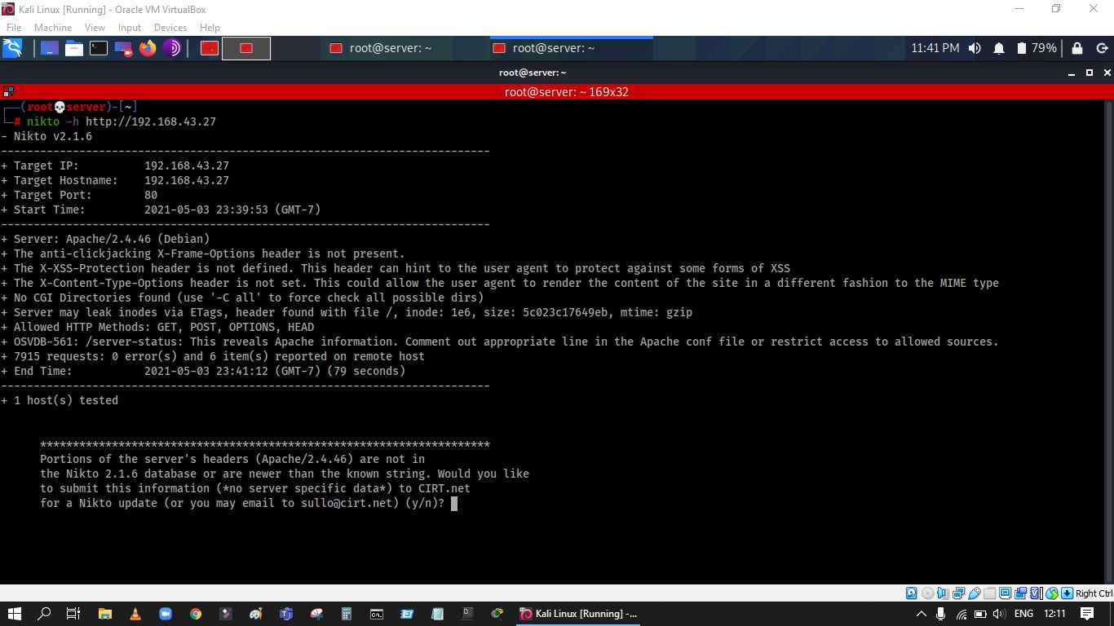

Slide 34
Clearing tracks!
TOOLS (CC CLEANER, etc,.)
BASED ON THE OPERATING SYSTEM CLEARING ENTRY LOGS

Slide 35
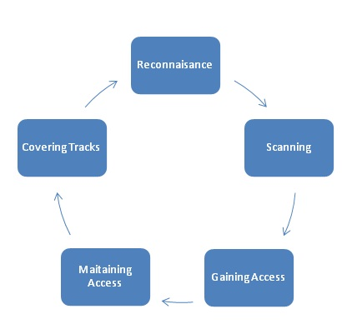
Methodology

Slide 36
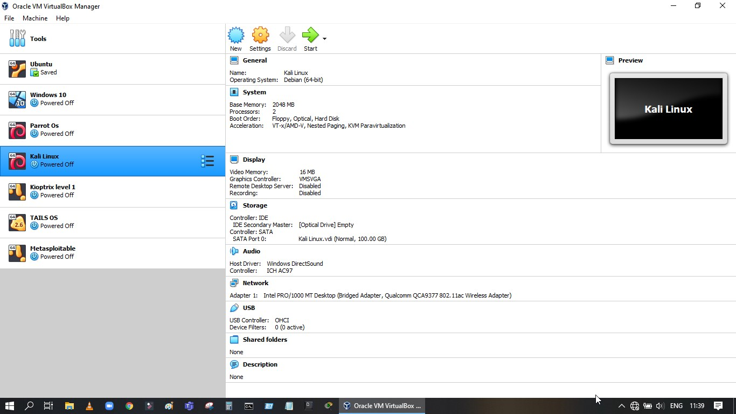

Slide 37
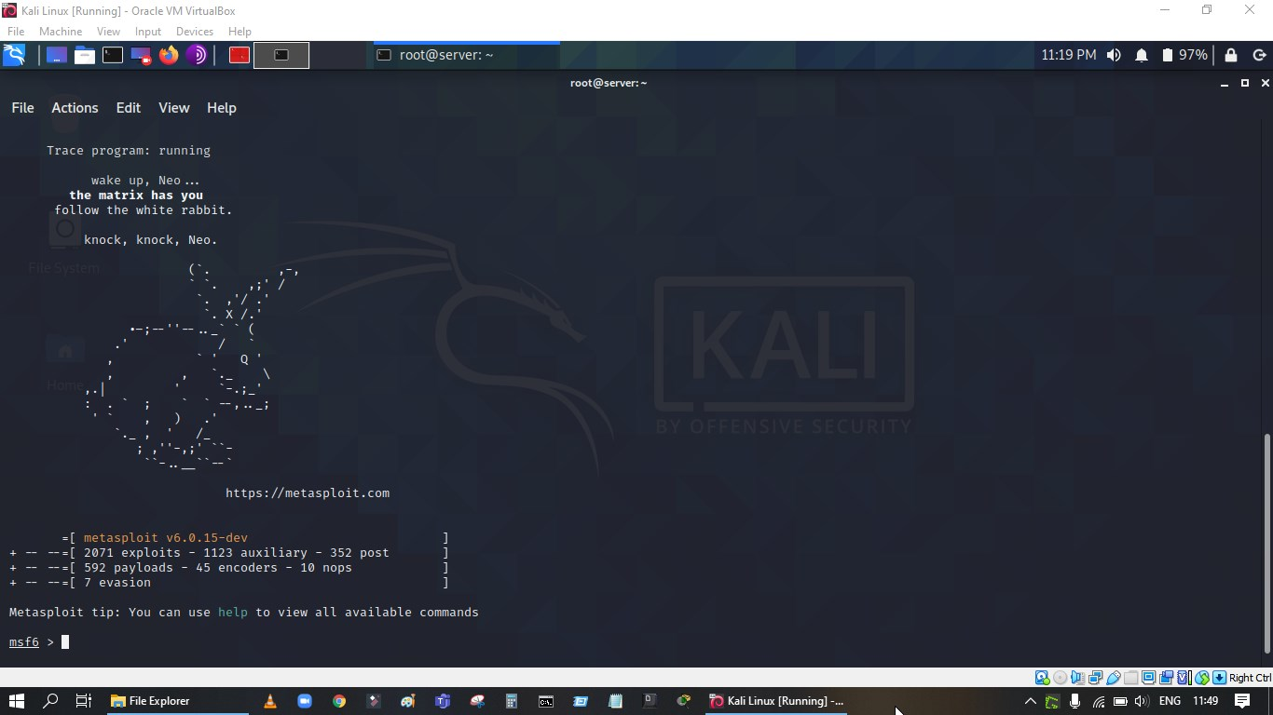

Slide 38
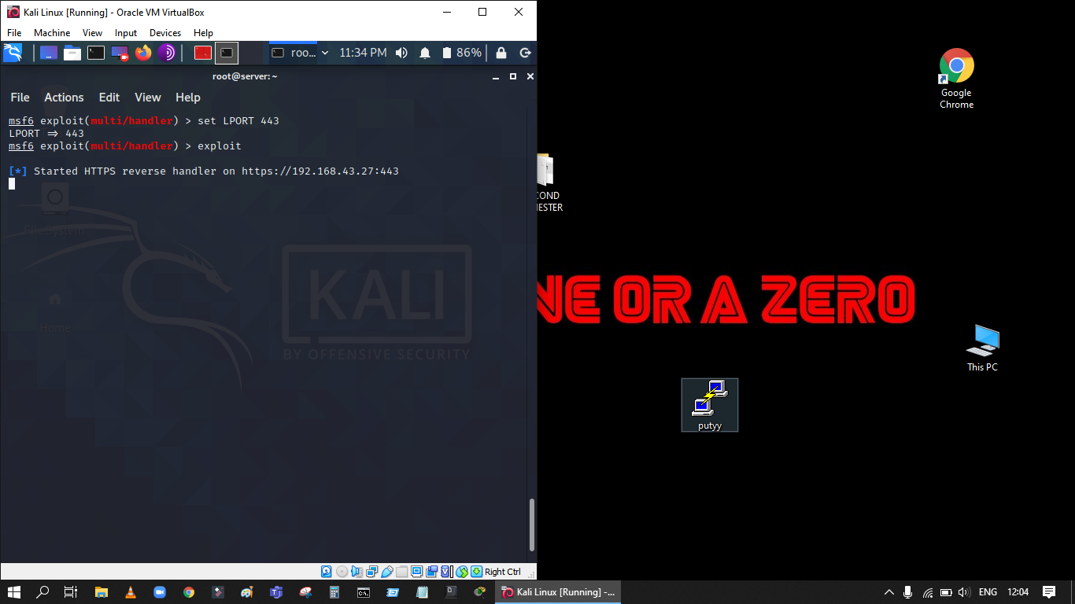

Slide 39
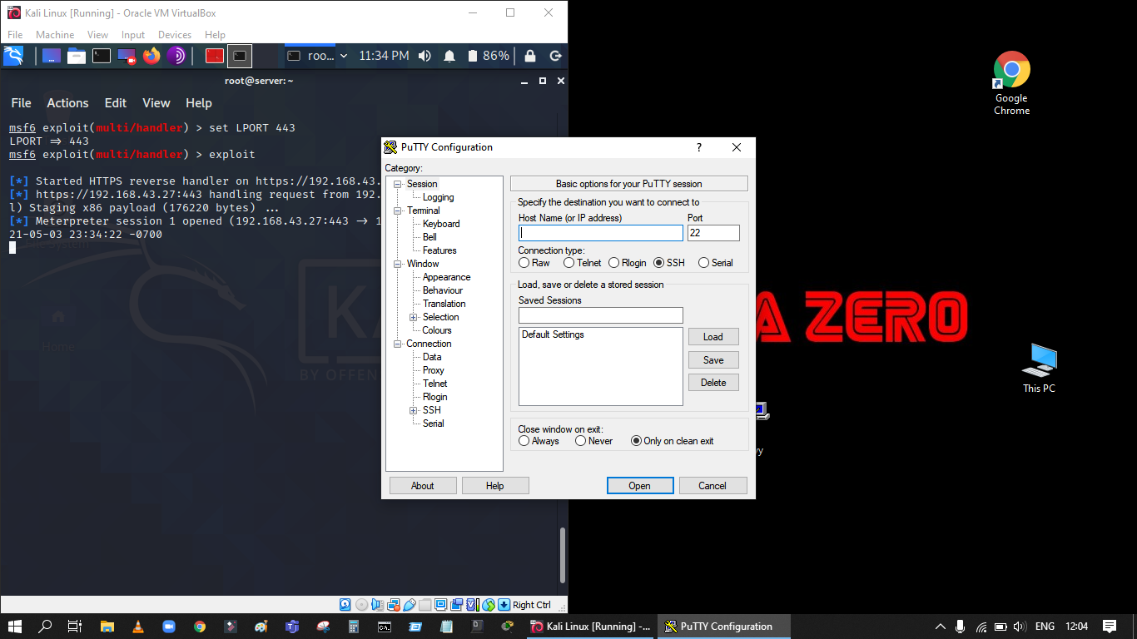

Slide 40
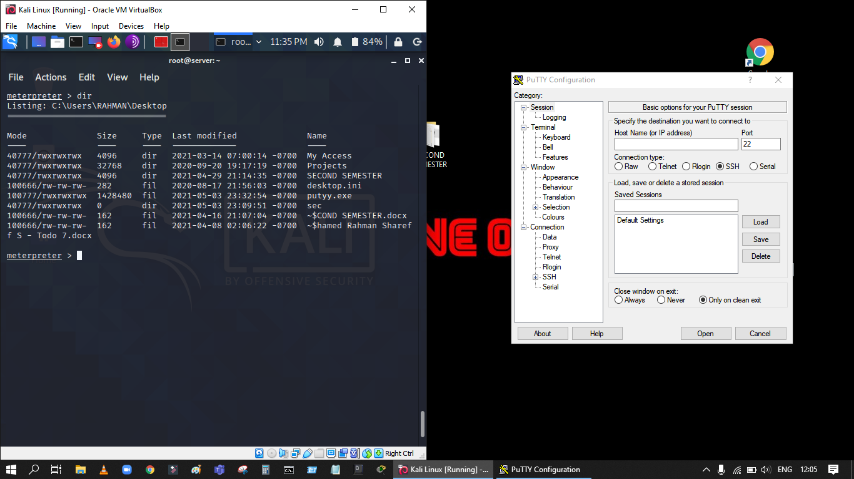

Slide 41
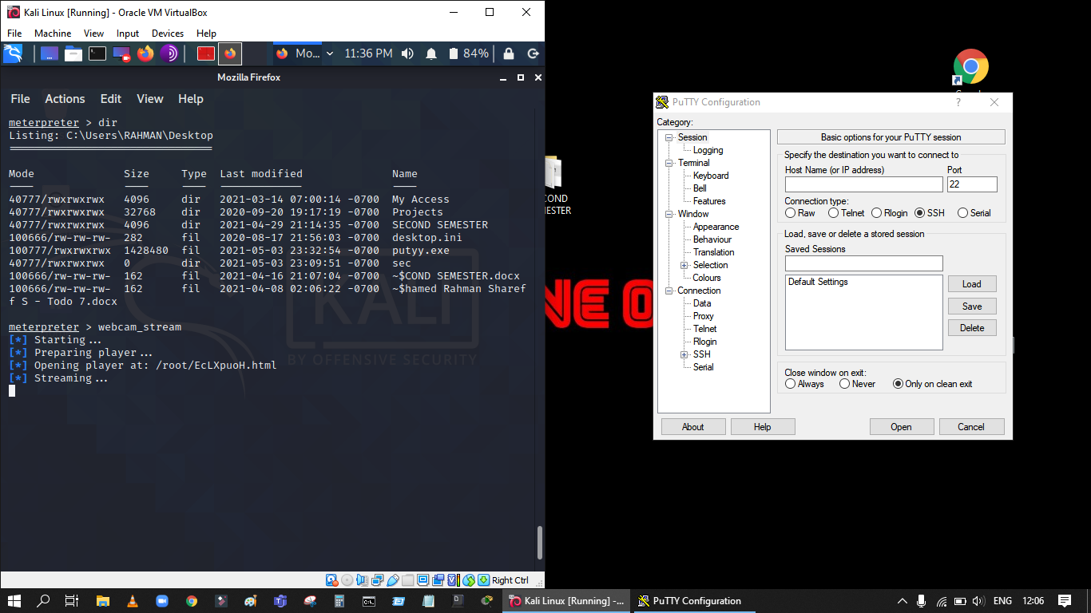

Slide 42
